Slide 1
Python ‘IOC’ (pcaspy)
Kay Kasemir, Feb. 2022

Slide 2
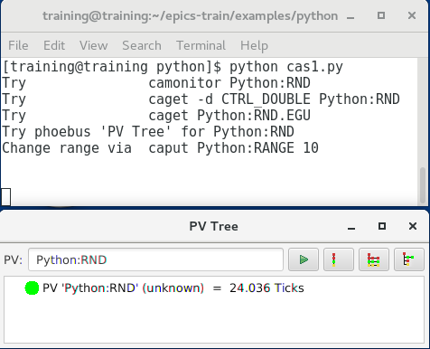
https://github.com/paulscherrerinstitute/pcaspy
CA Server library for python
cd /ics/examples/22_python
python cas1.py

Slide 3
More Examples
PV supporting put-callback
python cas2.py
CA Client as well as CA server
python cas3.py
For more, see pcaspy documentation: Access security, data types, ..

Slide 4
Caveats
CA server, no records
No xxx.RTYP, .EGU, .SCAN, …
No Autosave
DIY
No shell with ‘dbl’, ‘dbpr’, ‘casr’
DIY

Slide 5
Use Cases
Number Crunching
Numpy instead of CALC record
Outside Data Source
Access web services, relational databases, .. and serve results
Existing Python code
Turn script into IOC

Slide 6
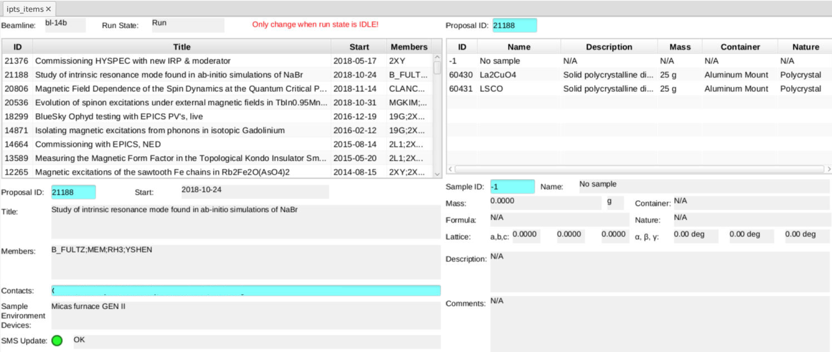
Example: Proposal Database

Slide 7
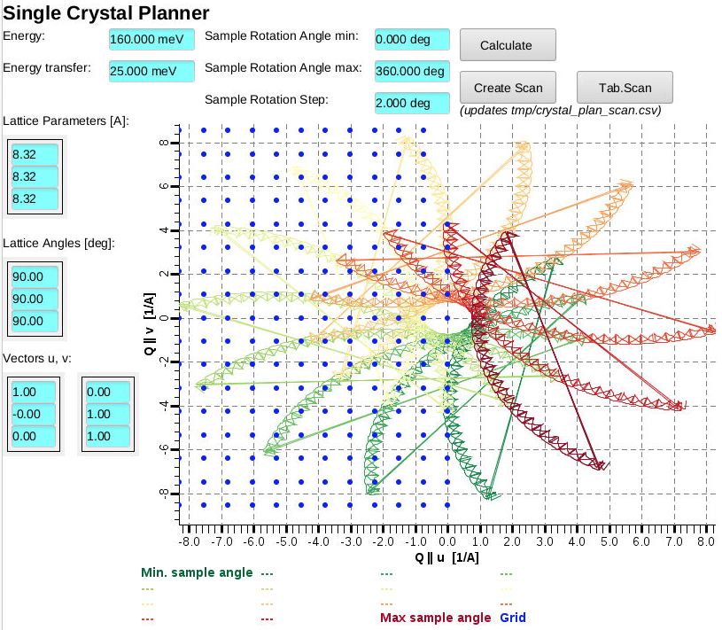
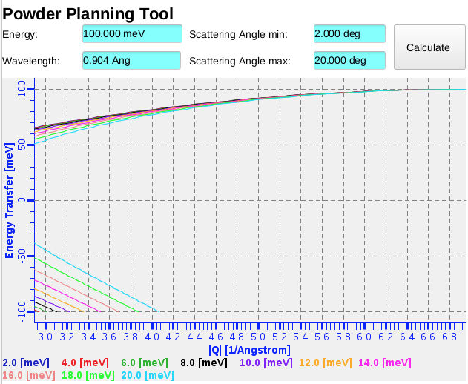
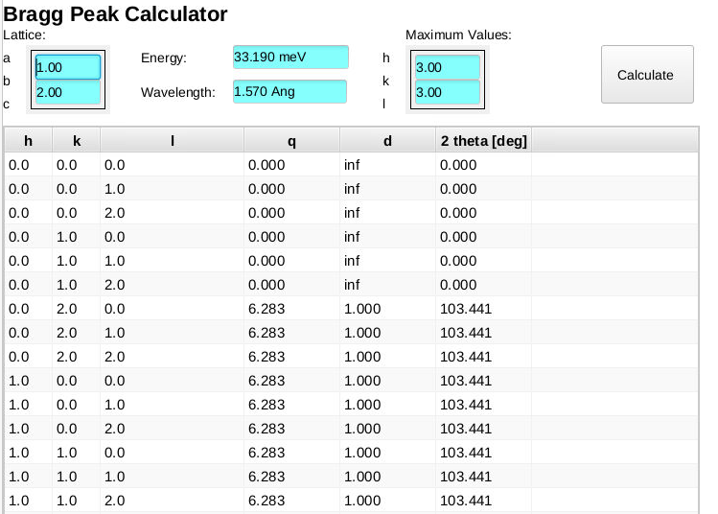
Example: Computations

Slide 8
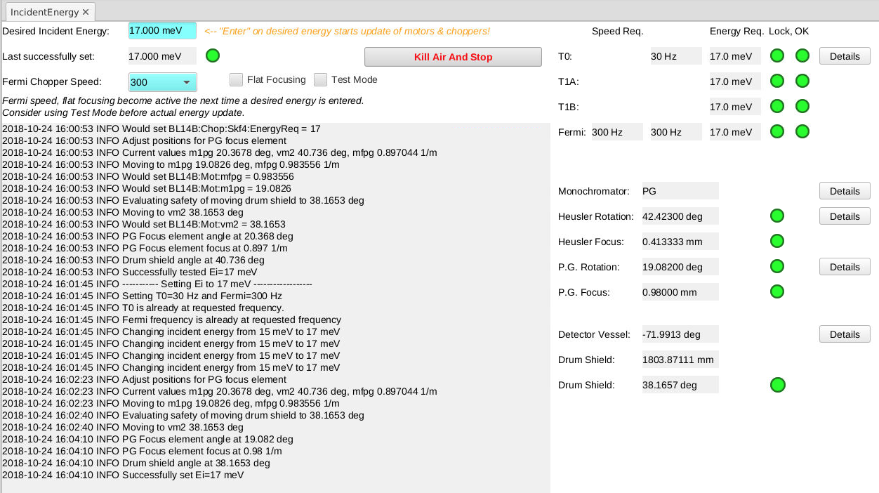
Energy Adjustment
Could use sequencer, but had existing python code

Slide 9
What if data is “Table” or Structure?
Channel Access can only handle scalar or arrays of number & string
On server side (pcaspy), ‘pickle’ python data into CA byte waveform
On client side (CS-Studio), read byte waveform PV in display script, ‘unpickle’, then display in table or …

Slide 10
Handling Table, Structure
Yes, pickled byte waveform is a hack
Requires scripts
Only works with python as server & client
pvAccess can handle custom structures
Better for server side
Client likely needs more than dump of structure; Will still require script for user-friendly display.

Slide 11
Summary
Python with CA server & client libs can act as IOC
Great tool to have
Doesn’t replace all IOCs

